Slide 1


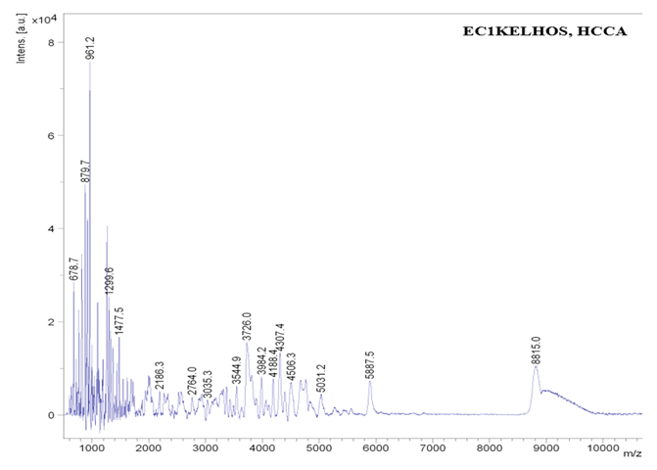
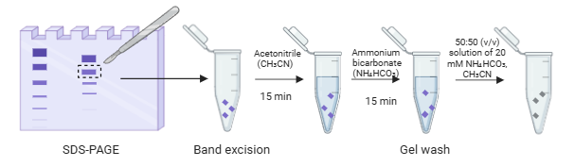
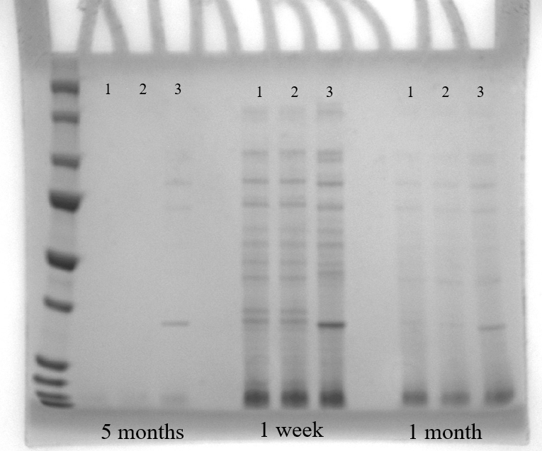

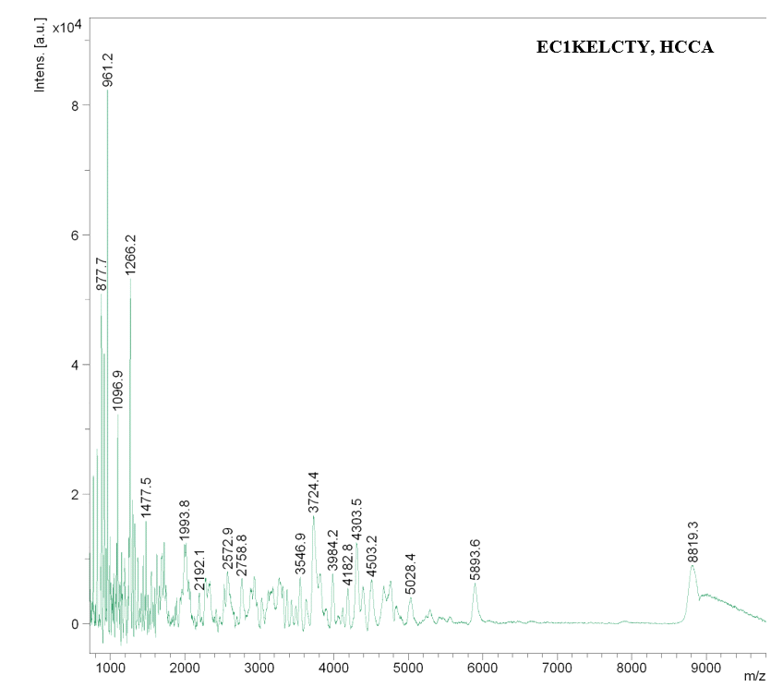
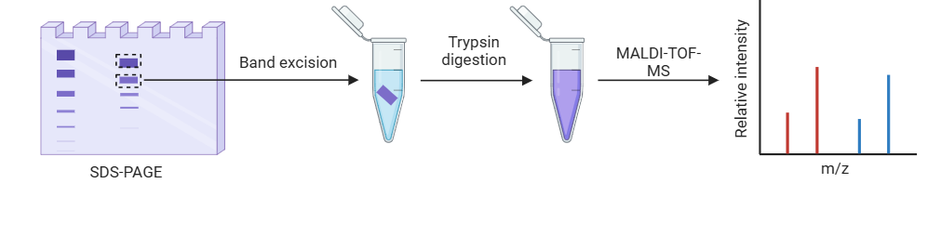
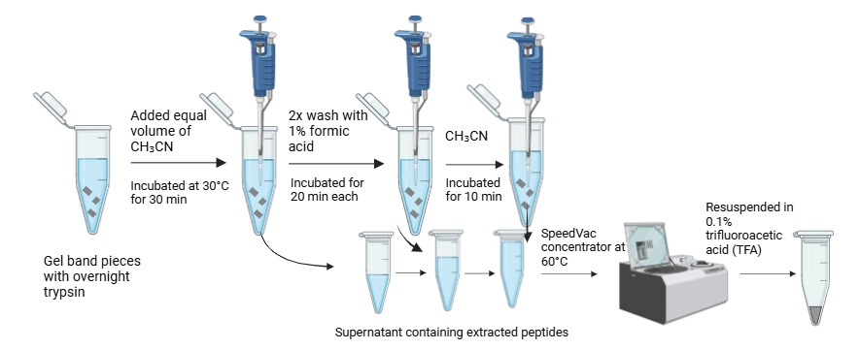
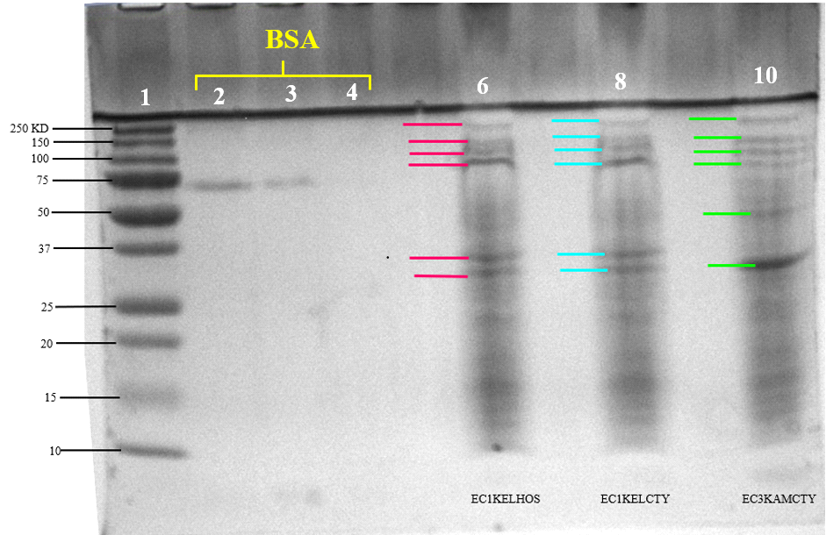
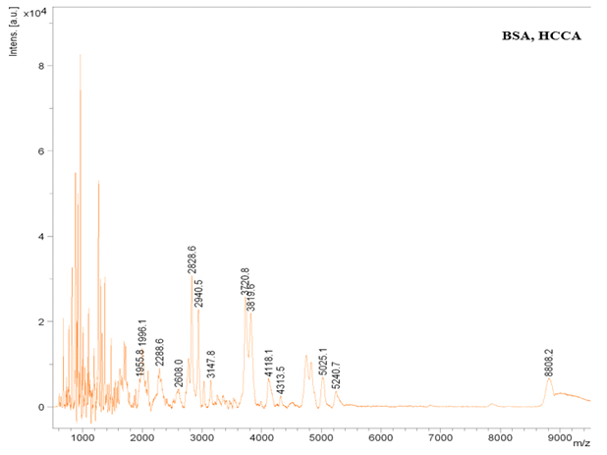
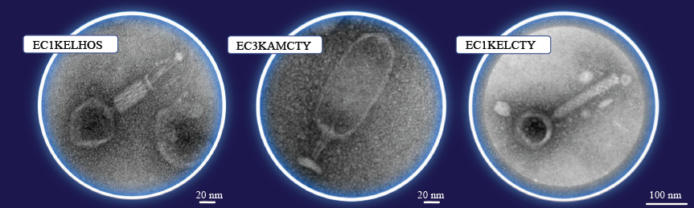
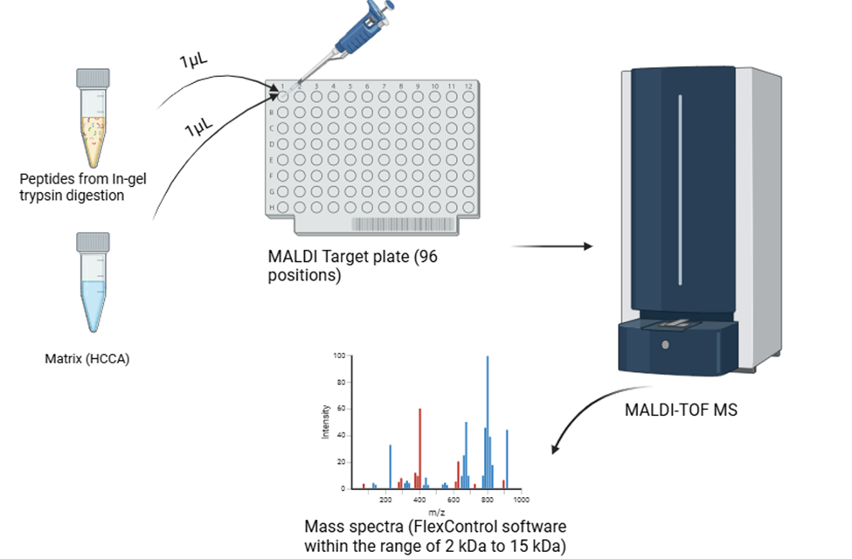
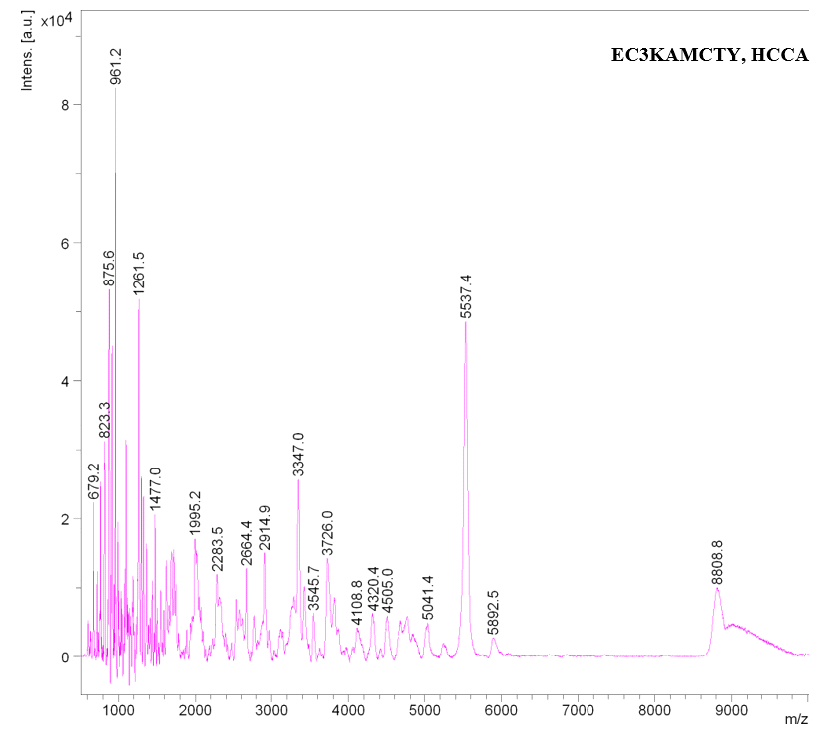
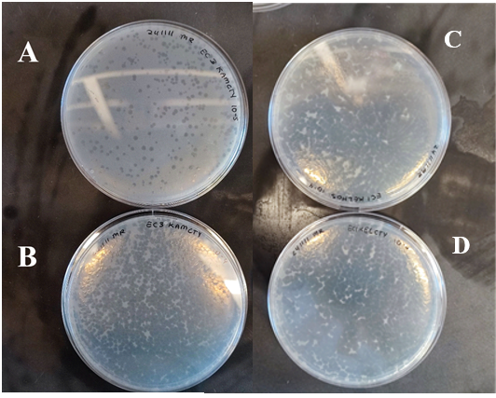

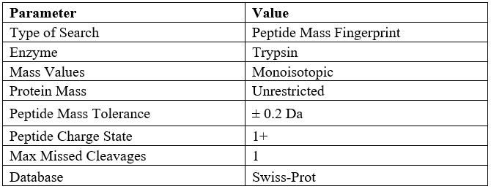
Sample Preparation Methodology for Detection of Bacteriophage Structural Proteins using MALDI-TOF-MS
Maria Alejandra Rojas Rivero
Faculty mentors: Naowarat (Ann) Cheeptham (Ph.D.) and Kingsley Donkor (Ph.D.)
Introduction
Methodology
Results
Today, some of the most common and effective techniques for microorganism identification are 16S rRNA and 18S rRNA gene sequencing [1].
Today’s methods are expensive, time-consuming, and labor-intensive, making them impractical for routine clinical use.
MALDI-TOF MS has emerged as a highly efficient tool for microbial identification and diagnosis [1]. It relies on minimal sample preparation and is significantly faster, cheaper, and more accurate for many applications.
In-gel digestion with trypsin is one of the most widely used techniques due to its efficiency and ability to produce clean, high-quality peptide samples.
Traditional solution-based digestion methods often use chemical denaturants such as urea or guanidine hydrochloride, which require extensive purification steps to remove contaminants incompatible with mass spectrometry [2].
In-gel digestion can mitigate these challenges by removing interfering substances during washing steps, resulting in peptides optimal for MS analysis [3].
1.SDS-PAGE gel band processing:
Effect of Storage Time on Phage Lysates for Protein Detection Using SDS-PAGE.
2.Trypsin Digestion:
Figure 7. MALDI mass spectra of EC1KELHOS bacteriophage strain proteolytic digest with trypsin obtained using HCCA matrix.
Figure 5. SDS-PAGE pre-cast gradient gel (4%-12%) first well containing BioRad precision Plus Protein Standards, (1) EC1KELHOS, (2) EC1KELCTY, (3) EC3KAMCTY. Results indicated that freshly prepared phage lysates exhibited higher protein density and reduced degradation compared to older samples. Lysates stored for 5 months showed less than half the protein density of the 1-week samples, emphasizing the importance of lysate freshness for protein stability.
3.Peptide Extraction:
MALDI-TOF analysis of peptides from in gel trypsin digestion.
Figure 8. MALDI mass spectra of EC1KELCTY bacteriophage strain proteolytic digest with trypsin obtained using HCCA matrix.
Figure 1. In gel trypsin digestion methodology. Desired gel bands are excised from SDS-PAGE gel and placed in a LoBind eppendorf tube, bands are washed to remove the dye from bands and trypsin digestion is perform, once peptides had been extracted solution is mixed with matrix and analyzed with MALDI-TOF-MS to obtain mass spectra.
4.MALDI-TOF-MS :
Figure 2. Transmission Electron Microscopy images of the three bacteriophages (UBC Bioimaging Facility RRID:SCR_021304 ).
Figure 6. 10% SDS-PAGE gel run with Tri’s buffer (pH 8.3) at 200V for 30 minutes. Lane 1 contains Bio-Rad Precision Plus Protein Standards. Lanes 2, 3, and 4 contain bovine serum albumin (BSA) at concentrations of 50 µg/mL, 25 µg/mL, and 12.5 µg/mL, respectively. Lanes 6, 8, and 10 contain bacteriophage lysates: EC1KELHOS (magenta bands), EC1KELCTY (blue bands), and EC3KAMCTY (green bands). Highlighted bands correspond to proteins of interest excised for in-gel trypsin digestion.
Figure 9. MALDI mass spectra of BSA proteolytic digest with trypsin obtained using HCCA matrix.
Proteins from bacteriophage strains EC1KELHOS, EC1KELCTY, and EC3KAMCTY were analyzed using MALDI-TOF mass spectrometry and MASCOT database searches. While EC1KELHOS and EC1KELCTY exhibited similar m/z patterns, EC3KAMCTY displayed a distinct peak at 5537 m/z. The highest protein scores obtained were 32, 36, and 42, respectively, though none met statistical significance (P > 55), indicating low confidence in identifications. Poor data quality, likely due to suboptimal digestion, sample preparation, and the absence of desalting steps, contributed to reduced peptide matches.
EC3KAMCTY
EC1KELHOS
EC1KELCTY
Figure 3. Plaques formed by bacteriophages in the double layer agar assay with the corresponding MDR bacterial hosts (E. coli#1 and E. coli#3).
Acknowledgements
Figure 10. MALDI mass spectra of EC1KAMCTY bacteriophage strain proteolytic digest with trypsin obtained using HCCA matrix.
Figures 1 and 4 were created using BioRender.com, which was instrumental in visualizing this project. I extend my sincere gratitude to Aman Galymov (Chemical Biology graduate) for generously providing bacteriophage samples, contributing to the initial project concept, and offering me the opportunity to continue this research. I am also deeply grateful to Dr. Naowarat (Ann) Cheeptham (Ph.D.) and Dr. Kingsley Donkor (Ph.D.) for their invaluable support and for allowing me to be part of this study. Special thanks to Dr. Don Nelson (Ph.D.) for his guidance on protein gel techniques and troubleshooting assistance. I also appreciate Kathy Baethke and Isaac Stephens (Laboratory Technicians) for their support in procuring project supplies. Transmission electron microscopy (TEM) images were obtained at the UBC Bioimaging Facility with the expertise of Dr. Naoji Yubuki and Dr. Miki Fujita (RRID:SCR_021304). Lastly, I acknowledge Royal Inland Hospital for providing the isolated bacterial strains essential to this research.
Conclusion
5.MASCOT Search Criteria:
SDS-PAGE revealed that freshly prepared lysates had higher protein density and less degradation, emphasizing the importance of lysate freshness for accurate analyses.
MALDI-TOF MS identified structural proteins, including capsid proteins from bacteriophage strains EC1KELCTY, EC1KELHOS, and EC3KAMCTY, with sequence coverage between 19% and 28%. Similarities between EC1KELCTY and EC1KELHOS spectra suggest structural resemblance.
Issues such as incomplete peptide desalting and sample complexity reduced spectral quality and hindered identification.
To optimize analysis, individual protein bands should be digested separately, and sample preparation improved by incorporating desalting steps, refining digestion conditions, and enhancing incubation methods. These refinements will improve peptide recovery and spectral accuracy, strengthening the methodology for routine application in phage proteomics.
Future work should address these limitations to enhance method robustness and precision in bacteriophage protein characterization.
Scan for references
Table 1. Mascot search parameters for peptide fragments identification.
Figure 4. The summary of the in gel trypsin digestion methodology and analysis of bacteriophage structural proteins .

